Slide 1
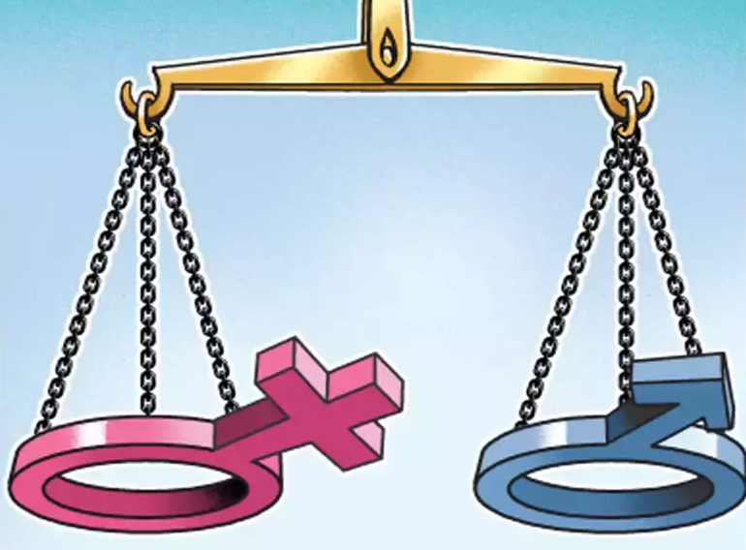
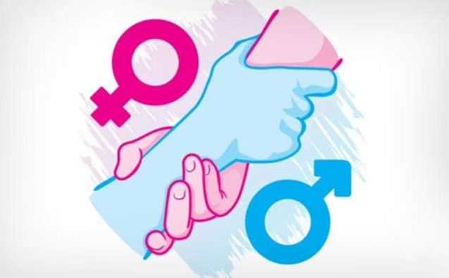
GENDER RATIO AT BIRTH IN INDIAN STATES

Slide 2
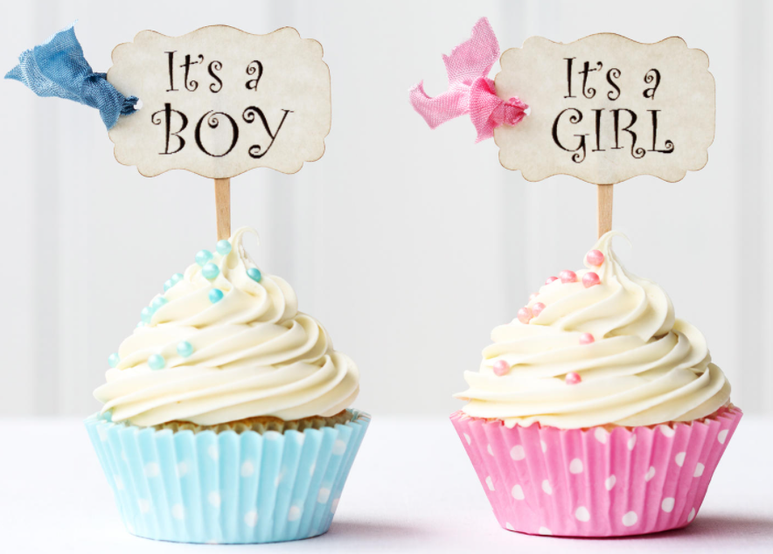

What is Gender Ratio?
The gender ratio is the demographic concept that measures the proportion of males to females in a given population.
In India, It is usually measured as the number of females per 1000 males.
The ratio is expressed as in the form of 990:1000, wherein this example there would be 990 females for every 1000 males in a population

Slide 3
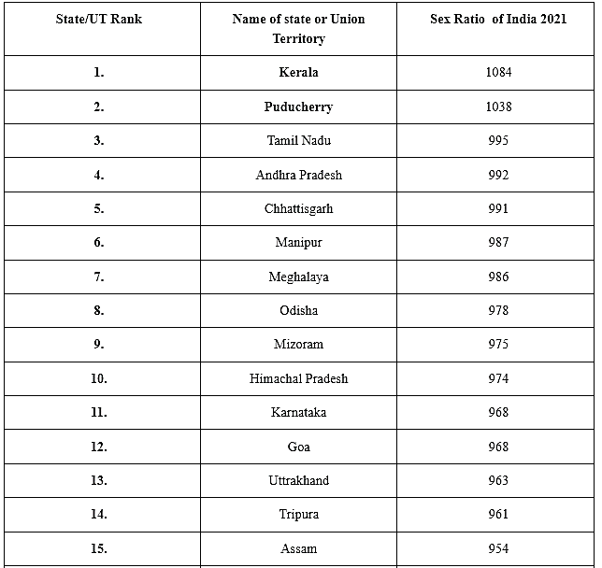
GENDER RATIO AT VARIOUS STATES

Slide 4
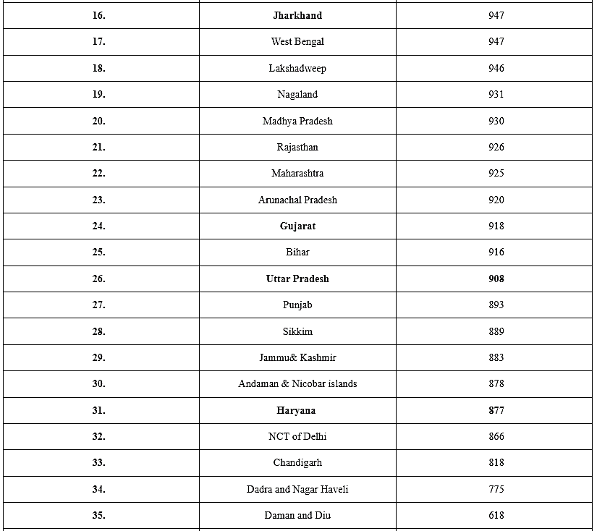

Slide 5
State having Higher Gender Ratio
KERALA is having Higher Gender Ratio in India.
REASONS:
Higher literacy rates
Lack of female infanticide trend
Upper caste Matriarchy

Slide 6
State having Lower Gender Ratio
DAMAN and DIU is having Lower Gender Ratio in India.
REASONS:
Substantial Immigrant Population
Highly Industrialized
Smaller area

Slide 7
Reasons for Lower Gender Ratio
Violence against women
Abortion of fetus
Female infanticide
Failure to teach equality values
Religious dogma with no scientific proof or basis

Slide 8
GENDER BIASED SEX SELECTION IN INDIA
The gender ratio of India’s population has been in favor of males in contrast to the situation in most of the world where women outnumber men in the population.
The practice of gender biased sex selection continues even though India has enacted laws banning the use of pre-natal diagnostic techniques for sex detection.
Strong Son Preference
Low total fertility rate
Existence of affordable reproductive technologies

Slide 9
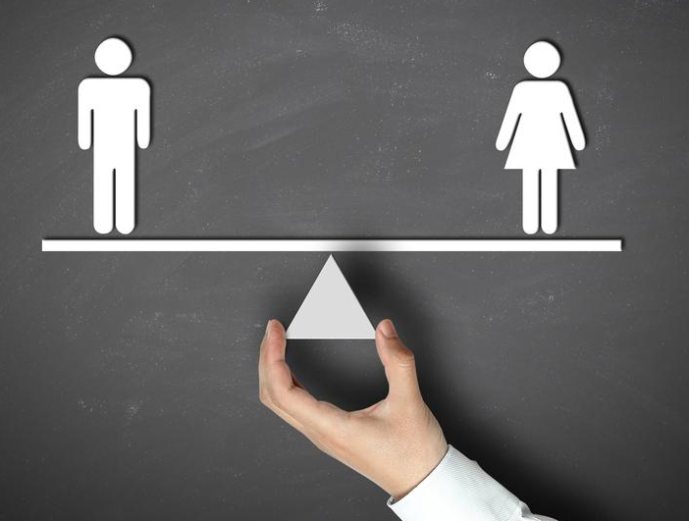
Why is higher gender ratio important for the country?
Studies have found that places with higher gender ratio have lower violent crime rates. This can also be seen in crime statistics of North and South India.
Improvement in gender ratio is also associated with lesser social tensions related to gender related issues and consequently lower crimes related to women.
Women making decisions is also more likely to benefit education and health outcomes of children.
Research in China has shown that high gender ratios have actually stimulated economic growth by inducing more entrepreneurship and hard work.

Slide 10
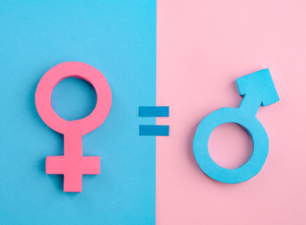
“Culture does not make people. People make culture. If it is true that the full humanity of women is not our culture, then we can and must make it our culture.”
THANK YOU

